Slide 1
Food Culture: Part 1
Rice Cultures 2019

Slide 2
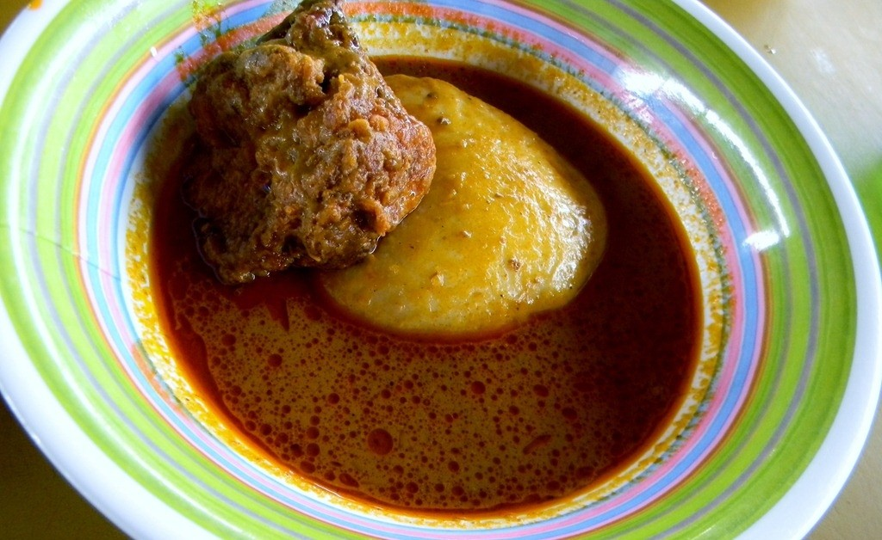
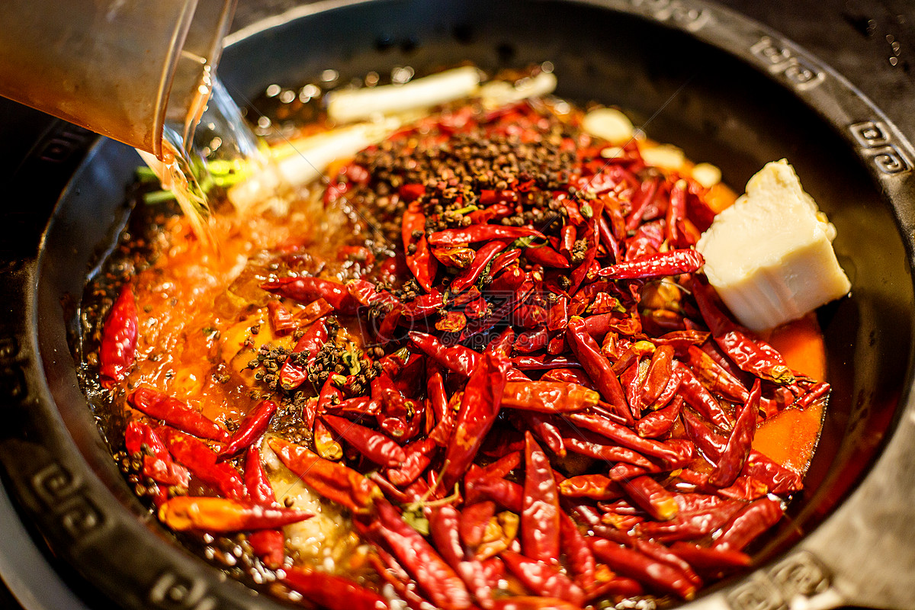
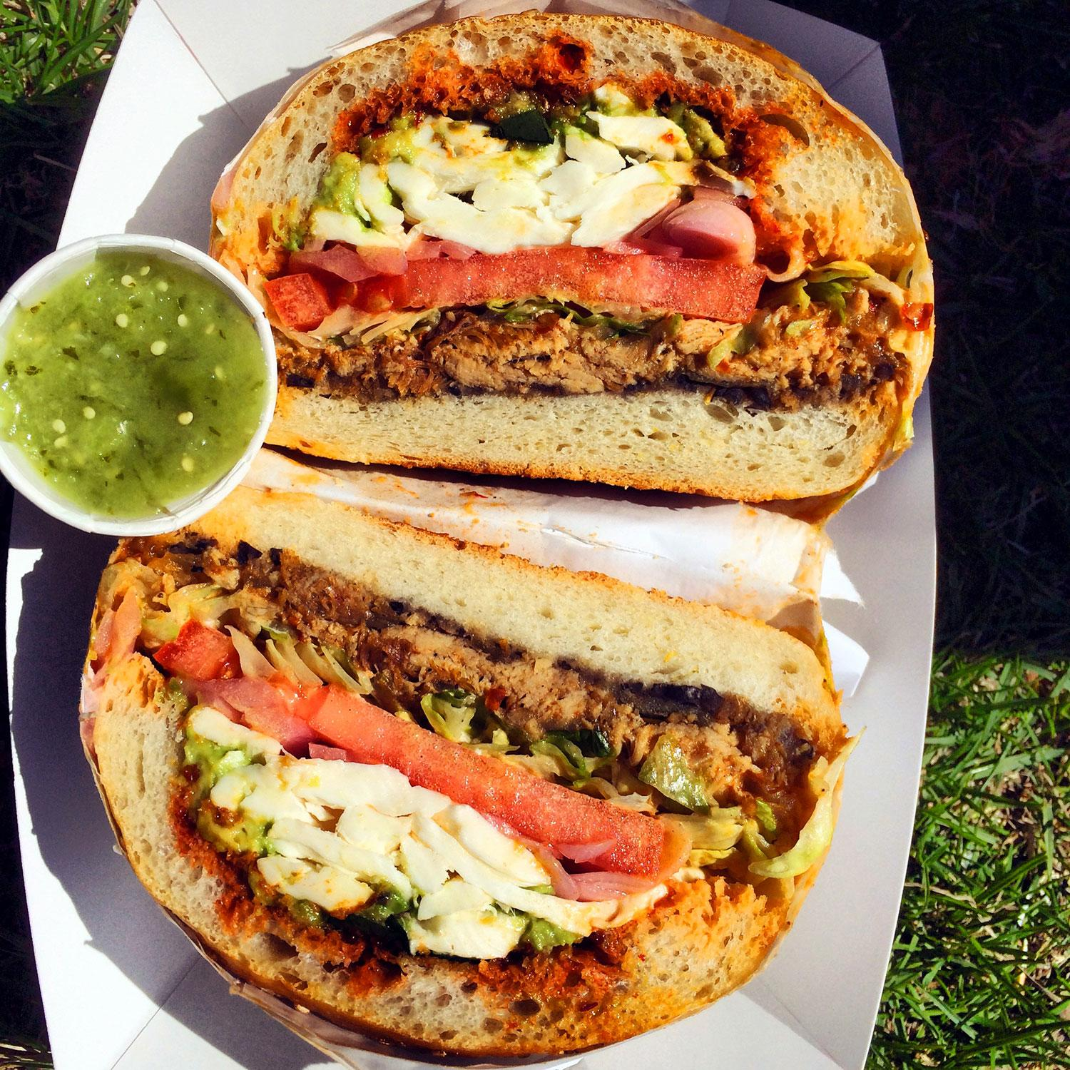

Slide 3
“Why are human foodways so diverse? Can anthropologists explain why specific food preferences and avoidances are found in one culture and not another?”
-Marvin Harris

Slide 4
Cultural symbols?
“For my part, I do not wish to deny that foods convey messages and have symbolic meanings. But which came first, the messages and meanings or the preferences and aversions? . . . .
“I hold that whether they are good or bad to think depends on whether they are good or bad to eat. Food must nourish the collective stomach before it can feed the collective mind.” (Marvin Harris, “Good to think or good to eat?,” 15)

Slide 5
Hypothesis 1: Nutritional Adequacy
Did gastronomic traditions and food cultures develop to meet nutritional needs?

Slide 6
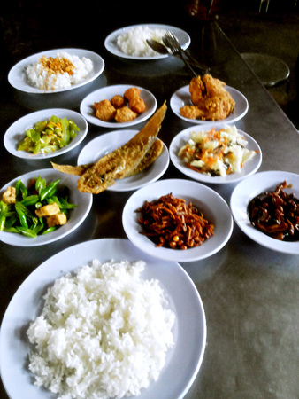
Patterns: the core-fringe hypothesis
Chinese meal:
Fan (rice)
+ Cai (dishes/vegetables/’relish’)
Cf. Chang 1977, Food in Chinese Culture

Slide 7
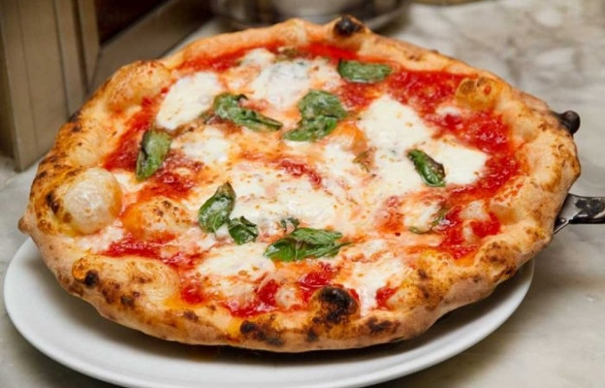

Slide 8
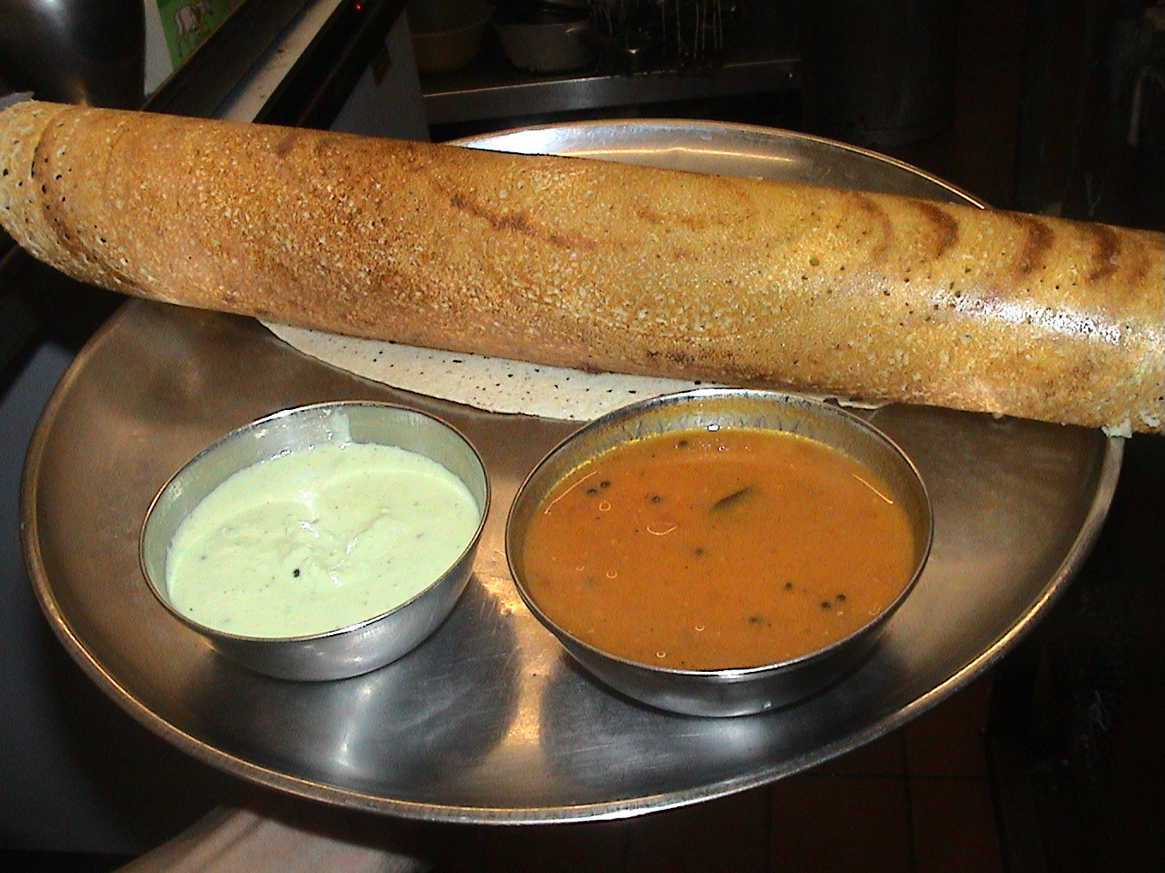

Slide 9
Method
Start with standard for daily allowances of nutrients (here: young adult men)
Calculate nutrients in each component of the diet
Assume that Core = 2/3 of calories (here 1650 kcal out of 2500)
1/3 (850) = ‘fringe’

Slide 10
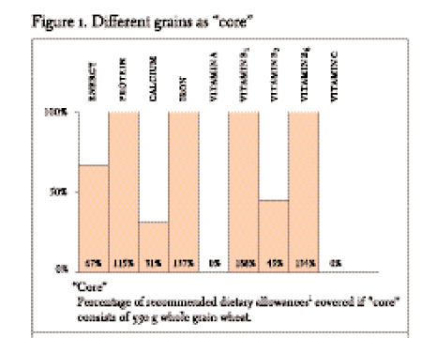

Slide 11
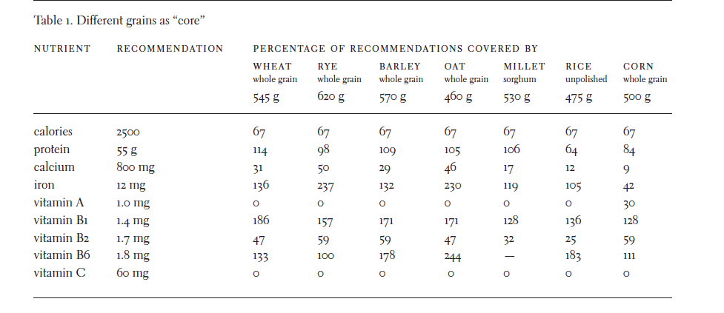

Slide 12
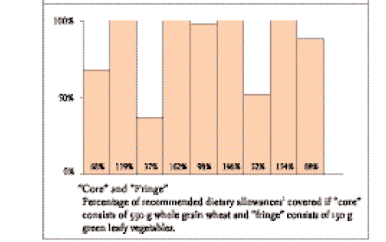
Grains + Fringe
Fringe = 150 g leafy green vegetables
Notes:
What other ’fringe’ would meet the necessary requirements?

Slide 13
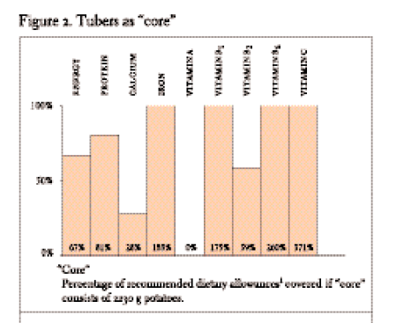
Tubers

Slide 14
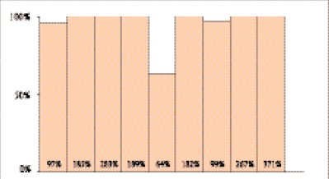
Tubers + Fringe
Fringe = 200 g. cheese

Slide 15
Calculate a meal
Pick any dish
Use the nutrition calculator to identify the nutrients provided by the dish—record both the absolute numbers and the percentage daily value
Does the dish or meal meet nutritional needs?
Does it follow a core-fringe pattern of balance/compensation?
Nutrient calculator: https://www.nutritionvalue.org/nutritioncalculator.php
Or: https://www.verywellfit.com/recipe-nutrition-analyzer-4157076

Slide 16
Hypothesis 2: Environmental Advantage

Slide 17
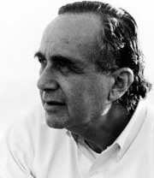
Marvin Harris
1927-2001
Cultural materialism
Became very controversial

Slide 18
“Preferred foods (good to eat) are foods that have a more favorable balance of practical benefits over costs than foods that are avoided (bad to eat).” Marvin Harris, ”Good to eat or good to think?” (15)
Nutritional costs and benefits
Time and effort to produce
Adverse effects on soils, animal and plant life, and environment
“Ecological restraints and opportunities which differ from one region to another”

Slide 19
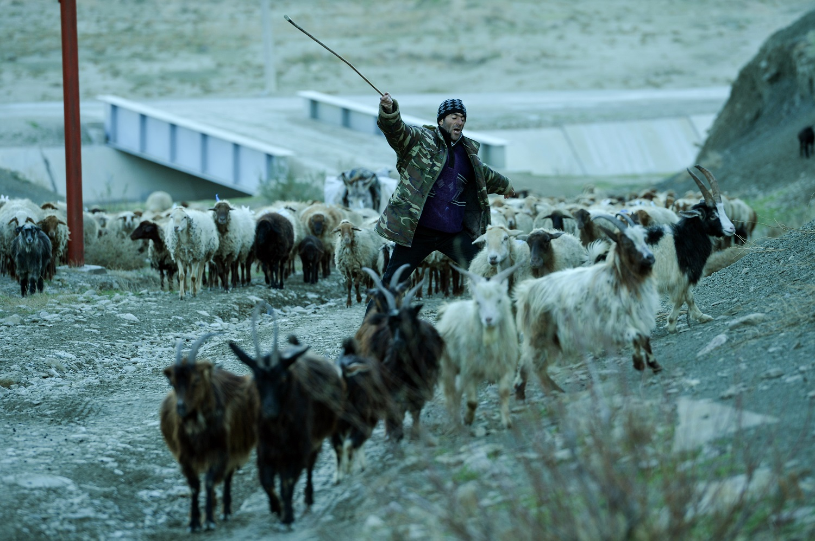
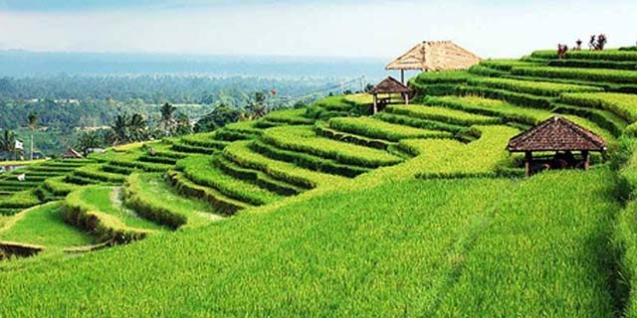
Herders
Cultivations

Slide 20

Food Prohibitions

Slide 21
Prohibition on killing or consuming cattle
According to Marvin Harris, why was consumption of cattle prohibited?
How does Harris’ argument differ from ‘nutritional adequacy’ hypothesis?

Slide 22
What is Harris saying about relation of (symbolic) culture and (material) environment?

Slide 23
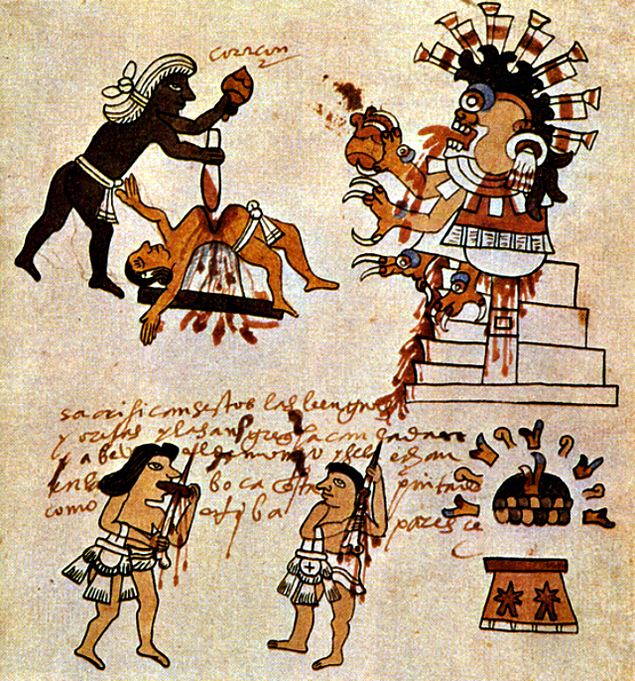
Aztec Human sacrifice

